Slide 1
EXPLORATORY ANALYSIS OF THE DATASET
BAN 502
February 20, 2022
Winslow E. Goins

Slide 2
Ames_student data set
The AMES_STUDENT data set contains 81 variables with 2053 observation
Each variable is a description of a feature of a house that was sold
The variables are divided into categorical and numerical variables
Numerical variables are units of measure of a feature (typically square feet)
Categorical variables can categories that can consist of the number of a feature (i.e. number of bathrooms), the condition/quality of a feature (i.e. fair, good, excellent), or the type of feature (i.e, roof type, heating system type).
The purpose of this exploratory data analysis is to determine which variables are strong predictor of whether a house will sell above or below the median home price.

Slide 3
Graphical analysis
To do an exploratory analysis of the dataset, a graphical representation of the data is performed to allow an individual to visually gauge the data.
Numeric variables are portrayed with boxplots that show the median, quartiles, and outlier data. Theses values can be compared to see if they are equally distributed for the above median price category or below median price category. Large differences in the values for the two categories could indicate the variable is a strong predictor.
Categorical variables are portrayed with bar plots with fill for the various categories. Like the boxplots, large differences in the fill area values for the two categories could indicate the variable is a strong predictor.

Slide 4
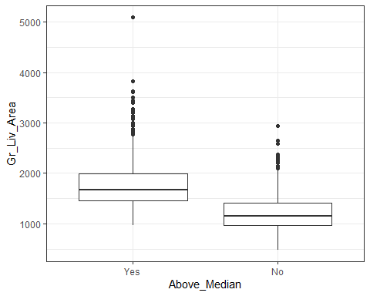
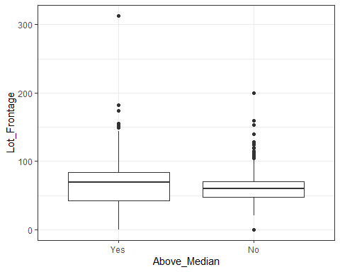
Box plot comparison
Box plot for a strong predictor
Box plot for a weak predictor

Slide 5
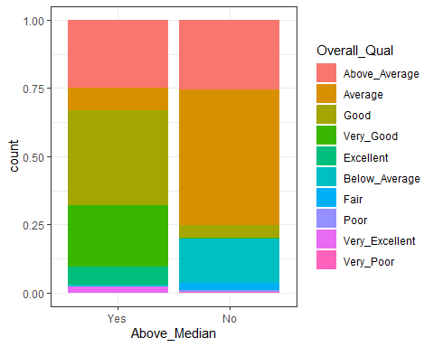
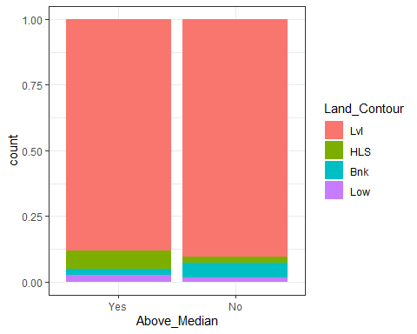
Bar plot Comparison
bar plot for a strong predictor
bar plot for a weak predictor

Slide 6
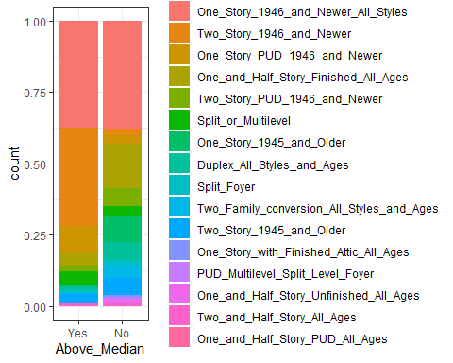
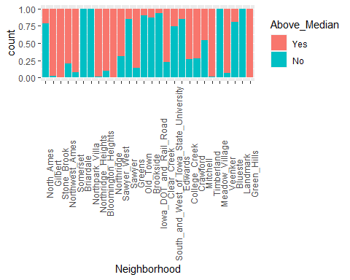
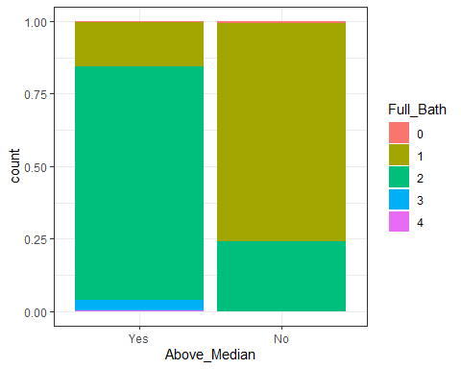
Additional Charts

Slide 7
summary
Based on the analysis of the graphs, the strong predictors generally follow size, year built, size of features, quality of features, number of features, and location. These variables follow natural reasoning and therefore are easy to consider.
While quality is significant, condition does not seem to be significant for the whole structure or the individual features. This seems to run against natural reasoning.
Variables that can be excluded due to the small number of response include: Misc_Val, Misc_Feature, Pool_QC, Pool-Area, Screen_Porch, Three_season_porch, Enclosed_porch, and Low_Qual_Fin-SF
A lot of the variables will probably show correlation due to the nature of the variables. Descriptors of basement features, garage features or other likewise features become dependent upon the feature existing. If a basement doesn’t exist, the basement quality and square footage would be none and 0, respectively. The neighborhood and latitude/longitude variables would show correlation due to both of them indicating location.

